Slide 1
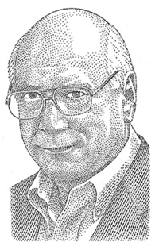
What will happen if we think about what is right with people rather than fixating on what was wrong with them?
Donald O. Clifton

Slide 2
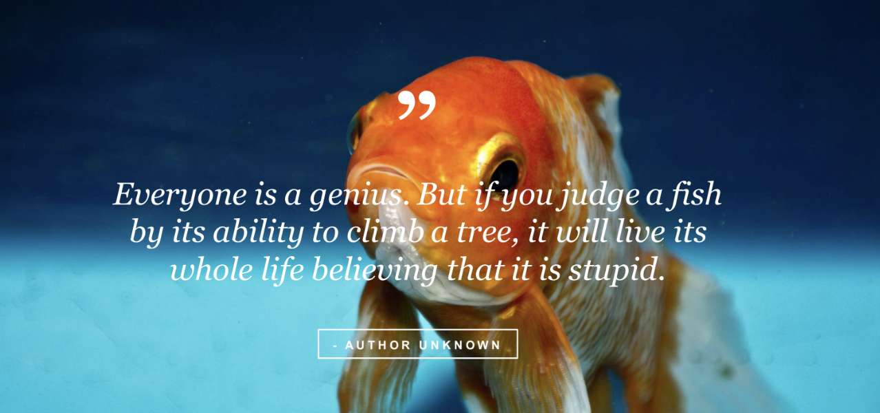

Slide 3
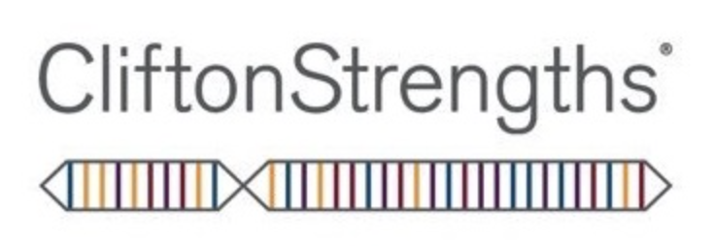
Why use the
Gallup’s

Slide 4
People that know and use their Strengths are…
      6X more likely to be engaged at work
      7.8% more effective in their role
      3X to have an excellent quality of life

Slide 5
      People work for People, not organizations

Slide 6
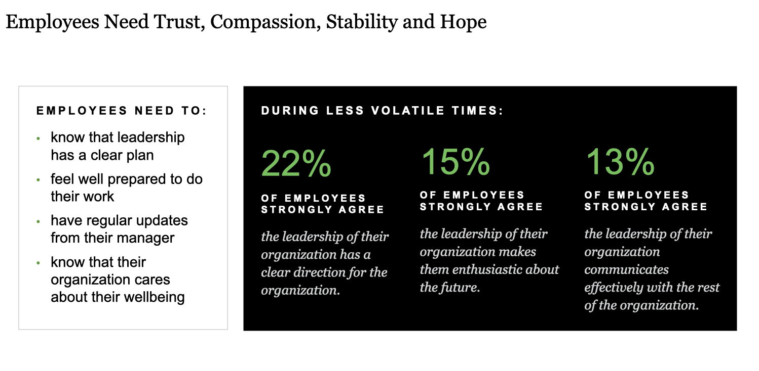

Slide 7
The Three Types
of Employees
1
ENGAGED employees work with passion and feel a profound connection to their company. They drive innovation and move the organization forward.
2
NOT- ENGAGED employees are essentially “Checked out.” They’re sleepwalking through their workday, putting in time – but not energy or passion – into their work.
3
ACTIVELY DISENGAGED aren’t just unhappy at work; they’re busy acting out their unhappiness. Every day, these workers undermine what their engaged coworkers accomplish.

Slide 8
      What does this chart tell you?
If your manager primarily: | The chances of you being actively disengaged are:
Ignores you | 40%
Focuses on your weaknesses | 22%
Focuses on your strengths | 1%

Slide 9
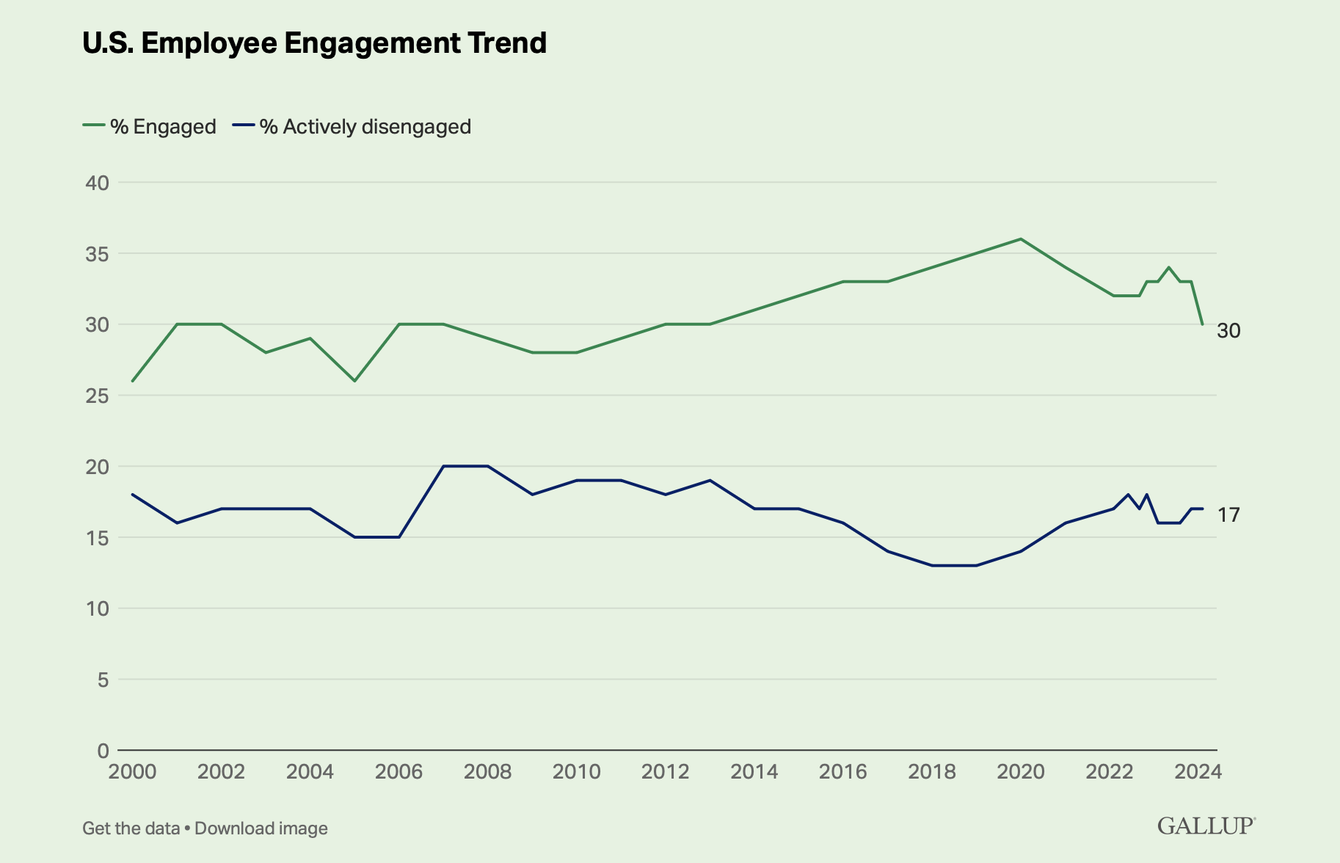
      30%

Slide 10
Talent (nature)
X Investment (knowledge/practice/effort)
= Strength
Notes:
Called StrengthsFinder, but it’s really “Talents Finder”

Slide 11
Weaknesses
(Anything that gets in your way of success)
Versus
Blind Spots
(You don’t see/know)
Notes:
Your greatest strength can also be your greatest weakness – this phrase describes blindspots.
Blind spots can be trickier: the “sinister underbelly” . (e.g., Activator often steps on toes, forgets to make everyone feel included.)

Slide 12
Using CliftonStrengths is ‘NOT’…
Justification to avoid meeting minimum standards (no, “get out of jail free" card)
Only ‘feel good’

Slide 13
Talents and Strengths are personal. They manifest differently in
different people.
      Why is this?

Slide 14
      What are your chances of having the exact same Top 5 in the exact same order as someone else?
      1 in
      33,000,000

Slide 15
2. Claim It!
3. Aim It!
1. Name It!

Slide 16
      Leadership Domains
      What do the colors mean?

Slide 17
Leaders with dominant strength in Executing domain know how to make things happen. When you need someone to implement a solution, these are the people wo will work tirelessly to get it done. Leaders with a strength to Execute have the ability to “catch” an idea and make it a reality.
EXECUTING
Leadership Domain

Slide 18
Those who lead by Influencing help their team reach a much broader audience. People with strength in this domain are always selling the team’s ideas inside and outside the organization. When you need someone to take charge, speak up, and make sure your group is heard, look to someone with the strength to influence.
INFLUENCING
Leadership Domain

Slide 19
Those who lead through Relationship Building are the essential glue that holds the team together. Without these strengths on a team, in many cases, the group is simply a composite of individuals. In contrast, leaders with exceptional Relationship Building strength have the unique ability to create groups and organizations that are much great than the sum of their parts.
RELATIONSHIP BUILDING Leadership Domain

Slide 20
Leaders with great Strategic Thinking strengths are the ones who keep us all focused on what could be. They are constantly absorbing and analyzing information and helping the team make better decisions. People with strength in this domain continually stretch our thinking for the future.
STRATEGIC THINKING Leadership Domain

Slide 21
Leadership Domains
EXECUTIING
INFLUENCING
RELATIONSHIP
BUILDING
STRATEGIC
THINKING
Leaders with dominant strength in Executing domain know how to make things happen. When you need someone to implement a solution, these are the people wo will work tirelessly to get it done. Leaders with a strength to execute have the ability to ”catch” an idea and make it a reality.
Those who lead by Influencing help their team reach a much broader audience. People with strength in this domain are always selling the team’s ideas inside and outside the organization. When you need someone to take charge, speak up, and make sure your group is heard, look to someone with the strength to influence.
Those who lead through Relationship Building are the essential glue that holds the team together. Without these strengths on a team, in many cases, the group is simply a composite of individuals. In contrast, leaders with exceptional Relationship Building strength have the unique ability to create groups and organizations that are much great than the sum of their parts.
Leaders with great Strategic Thinking strengths are the ones who keep us all focused on what could be. They are constantly absorbing and analyzing information and helping the team make better decisions. People with strength in this domain continually stretch our thinking for the future.
Notes:
COLORS DON’T MEAN ANYTHING
INDIVIDUAL CARDS
1st time = READ THE DEFINITION FOR EVERYONE
SPEND SOME TIME REFLECTING ON HOW THESE STRENGTHS PLAY OUT FOR YOU IN A WORK CONTEXT, SHARE YOUR REACTIONS
YOU’LL GET A FULL LISTING AT THE END

Slide 22
      Let’s discover and share strengths!

Slide 23
      3 Questions
      Which 1 of your top 5 do you ‘lead with’ at work?
      What is your #6?
      What is your #34?

Slide 24
