Slide 1

Powerful Graphic
          From the Core EAGL Finance Curriculum, Corey Bordine:
          a tool to better communicate financial ‘big picture’ elements
          to your team members on the front lines – dispelling misinformation about “where the $$ goes”

Slide 2
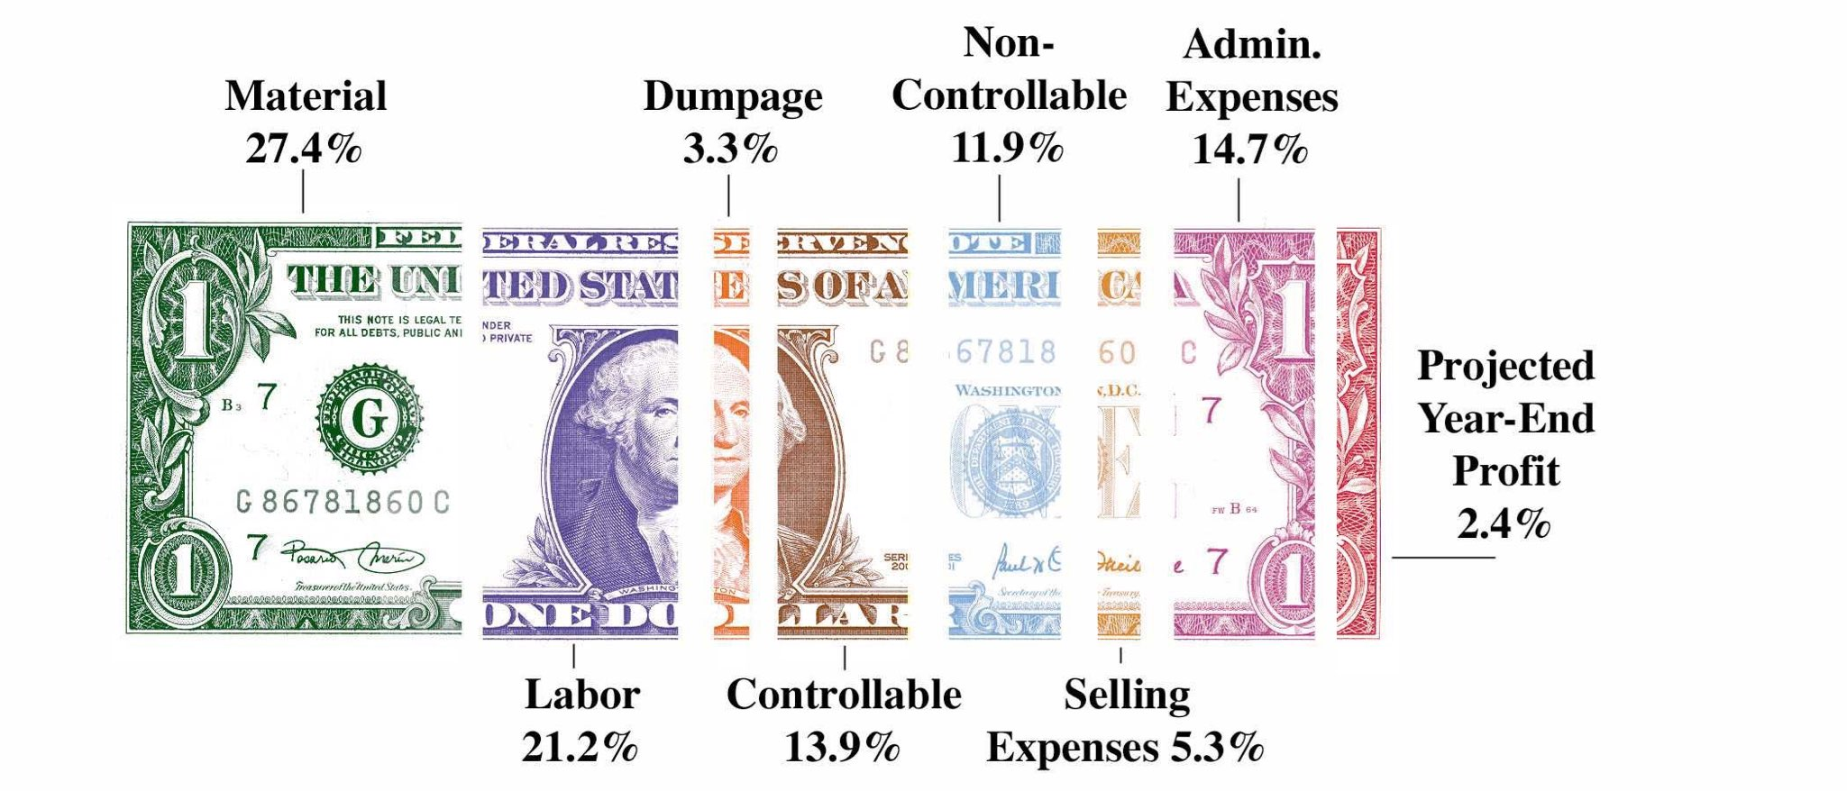
Powerful Graphic

Slide 3
Powerful Graphic
48.6% already spent

Slide 4
Powerful Graphic

Slide 5
Powerful Graphic

Slide 6
Powerful Graphic

Slide 7
Powerful Graphic

Slide 8
Powerful Graphic

Slide 9
Powerful Graphic

